Slide 1
Project Presentation/Demonstration
Contributing Authors:
Connor Misquitta
Joshua Barbieri
Lorien Cutler
Grace Tang

Slide 2
Overview
By functioning collectively, we are to plan and program an electronic framework for the Victorian state constituent commission. This new framework will take in new citizens' data such as their name, address, age, suburb and elector ID . This enables them to vote for the running candidates in Victoria. Clients can constantly refresh information across Victoria or abroad regardless of provider etc.
The new framework will be made utilizing C++ and will run effectively and efficiently functioning within the scope. The client-based interface will be intuitive and easy to use to as many users will be of advanced age.
The program has been designed to be simple and user friendly keeping all age demographics in mind in addition to understand not everyone is confident with technology. With those two ideas in mind, we went for a simple yet effective design to enable even the least tech savvy clients to be able to use our product.

Slide 3
Project Background
At present our discretionary bonus utilizes face to face polling form casting a ballot to choose our state lawmakers. This framework is exorbitant and not time productive and is inclined to 'jackass' votes wherein individuals submit phony or casual votes that can't be checked. The way toward casting a ballot is blocked by Victorian residents who are abroad or can't make it into the assigned democratic focuses because of sickness. The utilization of this E-framework would wipe out the requirement for polling form casting a ballot and diminish the time taken to handle the votes from abroad residents and give a simple and open approach to cast a ballot.

Slide 4
Project scope/objectives
- To carry out a functional application dependent on State appointive commission E-framework.
- Work all together, smooth, operable unit.
- Convey an extensive, articulate, and smooth show and exhibit of our useful application.
- As a Team unit have open clear correspondence and responsibility
- Guarantees an easy to use experience wherein electors are confronted with an efficient menu that will permit them to explore the E-framework easily.
- Won't crash if client inputs don't coordinate with the punctuation of the framework.
- Can take in new information from electors and add it to the previous data inside the framework and store it in a manner that will not be cleared by any future information.
- Successfully arranges information to be effortlessly perused and investigated for votes to be tallied and prepared.

Slide 5
Project outcomes/deliverables
As a group build a useable and natural viable application dependent on State constituent commission E-framework which incorporates the accompanying:
The reasonable application ought to have an unmistakable, obvious essential data set containing all the required and suitable data.
All written in C++, coded effectively, without blunders and have fitting remarks included.
All recorded prerequisites have been executed to the best.
Convey an excellent show and exhibition of the pragmatic application.
Work together, collaborate, delegate, and impart well as a group based unit.
Compose an expressive, compact, thoroughly examined report, that meets all measures to the best quality.
Generally speaking group and consumer loyalty is an ideal result as it will be a sign of moderate achievement.
Functional application can perform to a degree where the advantages can be seen constantly by clients when contrasted with a customary actual framework.

Slide 6
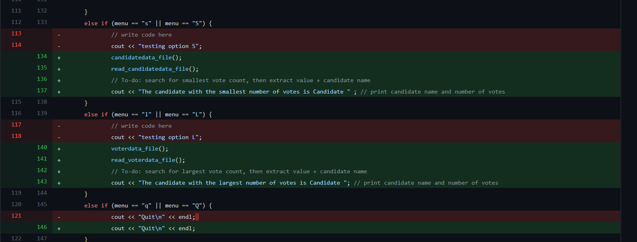
Preliminary design concept
Design /Development
We went through several phases when designing our program. Originally, we designed our database to work using a combination of C++ and SQLite, however this proved a bit too complicated to integrate with the menu section of our code.
From there we determined that a simpler solution would be to create and program files to act as databases. This made things simpler at the cost of the program being less dynamic in its function.
Our initial design for the menu was to make it as useable and intuitive as possible. We wanted something that met the brief but was also simple to use. This was done with older clients in mind as we knew the age demographic would be a wide spread of young and old. Therefore, we wanted our menu to be simple and easy to navigate
All our design work was placed into a website repository called GitHub. We then edited the stored code using source tree. These two programs were key to our designing. They allowed us to dynamically work on different designs at the same time so that everyone on the team could see what we were working on and how the different designs were going and how they were functioning.
As can be seen by the photo, this is our code for the menu stored in GitHub. We are able to constantly change the code so that everyone can see the alterations. Eg on line 134 you can see the line is highlighted green to indicate the line has been added and on line 113 the line is highlighted red to indicate it has been removed. This allows us to see the program dynamically change and evolve which from a design perspective is exceptionally useful. We are also able to write comments on what needs to be done in the project eg line 142 indicates that code needs to be written to perform a search for largest vote count.

Slide 7
Compatibility of Design
The solution we have created in our opinion completely meets the design requirements. The entire program has been done in C++ as was required and it includes the required two databases and the required menu. In addition to this the code for the solution has several comments to indicate what the functionality of the code is and what some more complicated parts of the code might do. Our code has been placed in a main function and there has been several iterations of testing that this program has gone through. This was seen in the previous slide as you saw the code was being tested and dynamically changed. Our variables and constant identifies are all clear and descriptive so that any other programmer could come along and look at our solution and know what everything does. This is further aided by the inclusion of code-level comments and block comments. We believe that our solution meets all the required design components including what has been mentioned above in addition to the list of validation requirements for our menu to be properly operable.

Slide 8
Code Demonstration
#include <iostream>
#include <cmath>
#include <vector>
#include <fstream>
#include <string>
using namespace std;
int voterdata_file()
{
ofstream voterdata;
voterdata.open("Voter Data Base.txt");
if (!voterdata)
{
cout << "File not created";
}
else
{
cout << "File created successfully!";
voterdata << "Voter Data Base\n";
voterdata << setw(15) << "Voter ID" << setw(15) << "Name" << setw(15) << "Age" << setw(15) << "Suburb" << setw(15) << "Status" << endl;
voterdata << setw(15) << 12345678 << setw(15) << "Tommy Sauche" << setw(15) << "23" << setw(15) << "Carlton" << setw(15) << "Student" << endl;
}
voterdata.close();
return 0;
}
This example of code is the solution we decided upon for our database. As you can see in the code, we are using a text file to write voter information into. This can be later opened and called on in the menu should someone wish to count votes for a candidate etc
The original design for our database was far too complicated for us to integrate as not everyone was familiar with using SQLite and therefore would have been counter productive to create a solution that the team were not sure of

Slide 9
Code Demonstration
int main()
{
// Taking in selection as a string, as the options are in alphabet letters
// Main menu
string menu;
cout << "Please enter your choice: \n";
cout << "Enter P - Print numbers for a particular candidate\n";
cout << "Enter A - Add number of votes to a candidate\n";
cout << "Enter S - Display the candidate with the smallest number of votes\n";
cout << "Enter L - Display the candidate with the largest number of votes\n";
cout << "Enter Q - Quit\n";
cin >> menu;
This chunk of code is for our main menu, specifically its more what the user is going to interact with, so essentially its our user interface. It isn’t anything flashy or complicated, but this was done by design to cater towards the older demographic that will need to user the system as well. Essentially when someone uses our solution they will be presented with these options and the program will run according to the selection that they make.
There will be a number of check and balances in place to make sure that people are unable to break the program by entering an incorrect input etc or a wrong calculation is made by the program.
Eg is a client pressed S or s then the program will open the candidate text file and search through the file for the candidate with the lowest votes and then output that information to the screen. This will be done using c++ code.

Slide 10
Thank you for listening!

